Slide 1
APRIL 2026
Clare County
Greetings, 4-H Families,
Spring has sprung! As the days get longer and the weather warms up, 4-H is blooming with activities, reminders and opportunities for your family.
April shower bring may flowers and our Annual 4-H Council Fundraising Committee Plant Sale will help you grow them! Be sure to check out the attached flyer for all the details on this year’s sale, including plant options and prices. Your fundraising efforts helps the council support our local 4-H youth. Thank you for helping our program bloom.
Sincerely,
Renee Sanders
4-H Program Coordinator
Renee Sanders
4-H Program Coordinator
Michigan State University Extension
Clare County Courthouse
225 W. Main Street
Harrison, Michigan
48625
(989) 539-7805
biselr@msu.edu
Fair Board Meeting | 4-14-2026 | 7 pm | TBD
Art in Nature | 4-19-2026 | 1-2 pm | Jay’s and Webber Wildlife & Education Center
4-H Council Meting | 4-22-2026 | 6 pm | Clare Pere Marquette District Library
Sheep and Dairy Feeders Weight In | 4-24-2026 | 5-7 pm | Clare Co Fairgrounds
Swine Weigh In | 4-25-2026 | 9-11 am | Clare Co Fairgrounds
Plant Sale Orders Due | 4-27-2026 | 4 pm | MSU Extension Office
Enrollment Deadline | 5-1-2026 | mi4honline.com
https://www.canr.msu.edu/county/

Slide 2

Building awareness in
4-H experiences
April 1-21: Smart Money Missions Goosechase Game
Online (Goosechase App)
Join an interactive scavenger hunt game designed for youth to learn essential money management skills while having fun. Players age 13-19 complete creative missions, answer trivia and solve puzzles, all while earning points to climb the leaderboard.
www.canr.msu.edu/events/smart-money-missions
April 12: Michigan 4-H Day with the Detroit Tigers
Comerica Park, Detroit
Join Michigan 4-H and MSU Extension for a fun day at the ballpark as the Detroit Tigers take on the Miami Marlins on Sunday, April 12. Michigan 4-H will be honored as the Group Charity of the Game.
www.canr.msu.edu/events/michigan-4-h-day-with-the-detroit-tigers
April 13: Adulting 101 – Eat Smart: Meals on a Budget
Online
Simple tips to plan meals that save money and taste great. Plus learn how to cook once and eat twice!.
www.canr.msu.edu/events/adulting-101-eat-smart
April 17 – May 3: Spring TSC Paper Clover Campaign
Tractor Supply Stores everywhere
Support 4-H by purchasing a $1 paper clover at your local Tractor Supply Co. (TSC) store!
www.canr.msu.edu/events/spring-tractor-supply-co-paper-clover-campaign
April 21: Make the Most of Your Market Animal Project – Goal Getters
Online
Learn how to set SMART goals to enhance your livestock marketing success. Youth with learn practical strategies to develop a goal, stay focused and achieve it.
www.canr.msu.edu/events/market-animal-project-webinar4-21
April 22: Michigan 4-H Volunteer Webinar – Let’s Talk it Out: Handling Conflict with Ease
Online
Conflict happens—even to the best volunteer groups. Learn how to handle tough conversations without the stress. Pick up practical tips for turning disagreements into productive dialogue and keeping your volunteer experience positive and drama-free.
www.canr.msu.edu/events/michigan-4-h-volunteer-webinar-let-s-talk-it-out-handling-conflict-with-ease
April 28: Make the Most of Your Market Animal Project – Talk the Talk
Online
Effective communication is key to successfully selling livestock. Learn tools and techniques to connect with buyers, convey product value and empower youth with tips for impactful auctions and markets.
www.canr.msu.edu/events/market-animal-project-webinars-april-28
Helping young people understand that they are part of 4-H and what that means is a key part of strengthening their overall experience. Awareness builds pride, connection and a sense of belonging.
As volunteers, you play an essential role in helping youth and families recognize when they are participating in 4-H and how activities connect to the values and learning within the program.
Simple, intentional steps can make a big difference.
Have the 4-H flag and recite the 4-H pledge.
Use the 4-H clover on handouts and materials when possible.
Make clear connections between activities and one of the four Hs.
These actions help youth see themselves as true 4-H members engaged in meaningful learning.
#BeyondReady

Slide 3
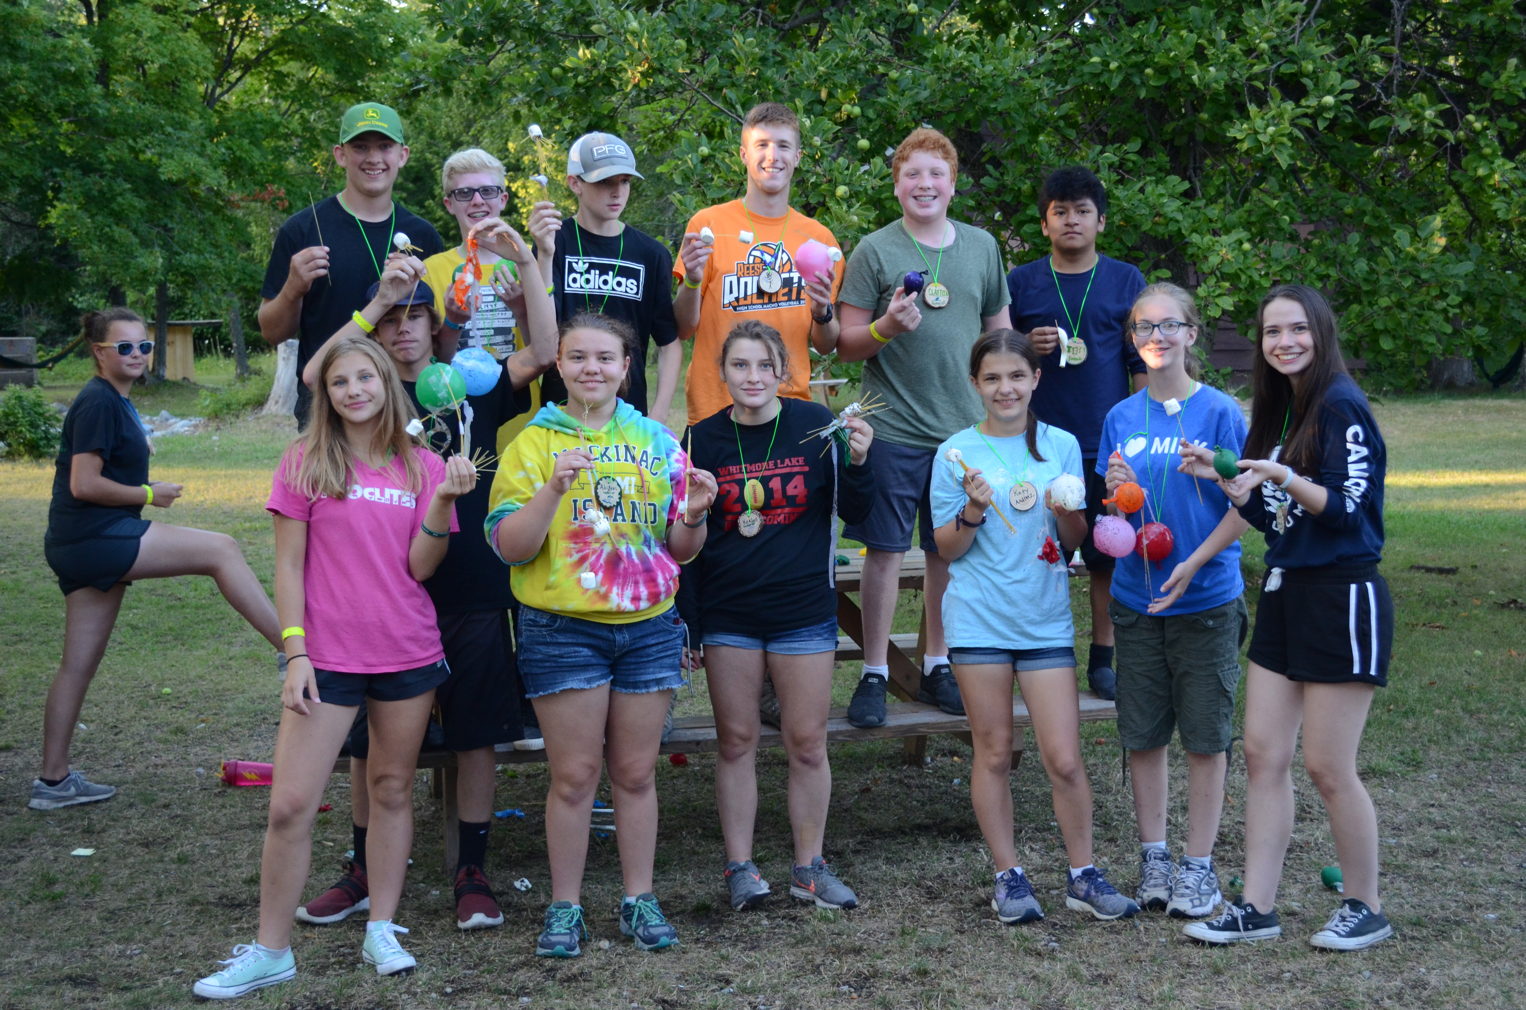
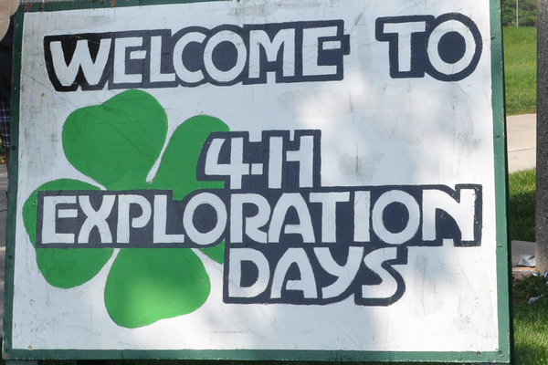

Registration open for 4-H Great Lakes and Natural Resources Camp
4-H Great Lakes and Natural Resources Camp mixes summer fun and hands-on science education. The camp will be held July 26 – August 1 on the shores of Lake Esau at Camp Chickagami in Presque Isle and is open to youth ages 13-15 during camp.
During this enriching MSU Extension educational program, campers will increase their science literacy and stewardship as they learn from natural resource experts in fields such as Great Lakes coastal and fisheries management, limnology, wildlife, forestry, geography, geology and environmental education. In addition to hands-on learning, attendees also enjoy exciting natural resources recreation activities such as kayaking, swimming, sailing, archery, fishing, snorkeling, evening campfires and more!
Registration is now open! The registration fee is $550 and includes six nights of lodging, all meals and snacks, a t-shirt and program and activity costs. Space is limited to 70 campers so register today. For more information and to register, visit www.canr.msu.edu/4_h_great_lakes_natural_resources_camp/.
Register for 4-H Exploration Days!
Join 1,000 youth from across Michigan on MSU’s campus to explore YOUR future! This three-day pre-college program is designed to help you explore careers, build skills and envision your future. Choose from more than 100 fun learning sessions on a variety of topics that are led by MSU faculty, 4-H staff and volunteers, and other experts. You’ll stay in and eat at MSU residence halls, attend sessions in buildings throughout campus, and of course have fun at free-time activities across the university!
4-H Exploration days will be held June 24-26 at MSU in East Lansing. Young people ages 12 to 19 are invited to join the fun! The cost for the 2026 event is $250, which includes two nights’ lodging in a residence hall, meals, learning sessions, an event t-shirt and free-time activities. Contact your local MSU Extension office to find out if your county 4-H program offers scholarships for youth participants.
Registration is open and closes April 17. You’ll want to register soon – sessions fill up fast and are assigned on a first-come, first-served basis! For registration links or more information, visit www.canr.msu.edu/4_h_exploration_days/.
Purple up for military families!
April is the Month of the Military Child, an annual awareness campaign that recognizes the sacrifices made by military families and their children. In partnership with many others across the United States, Michigan 4-H Military Partnerships is participating in the annual “Purple Up!” Day event. To show your support of children whose parents are serving in the military, MSU Extension and Michigan 4-H are asking residents throughout Michigan to Purple Up! on April 15.
The color purple is chosen as the signature color because it symbolizes all branches of the military. It is a combination of Army green, Coast Guard blue, Air Force blue, Marine red and Navy blue. Michigan 4-H Military Partnerships hopes everyone will take this opportunity to appreciate and celebrate all of our state’s young heroes strength and sacrifice as their parents serve. Let’s show our military families how much we appreciate their service by encouraging everyone to Purple Up!
Looking for more ways to celebrate Month of the Military Child? Visit www.4-hmilitarypartnership.org/month-of-the-military-child.html. For more programs and resources available to military families through Michigan 4-H, visit www.canr.msu.edu/4h_military_families.

Slide 4


Slide 5
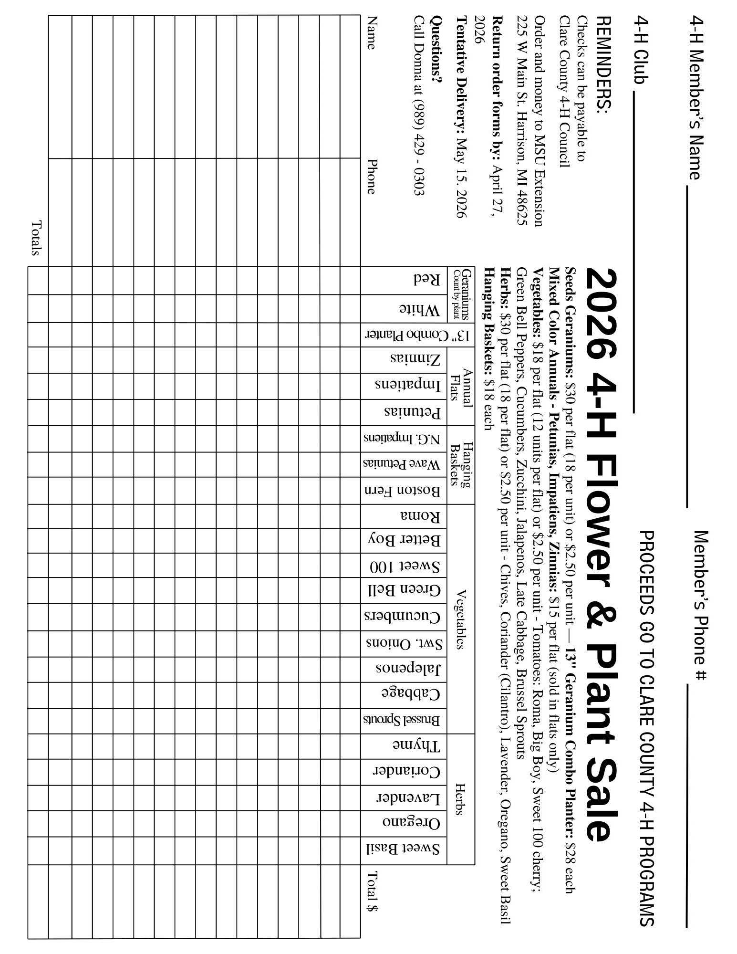

Slide 6
Michigan State University Extension
Clare County
225 W Main Street
Harrison, MI 48625
Clare County
Learn more about how you can grow with Michigan 4-H!
https://www.canr.msu.edu/clare/county-extension-office

